Slide 1
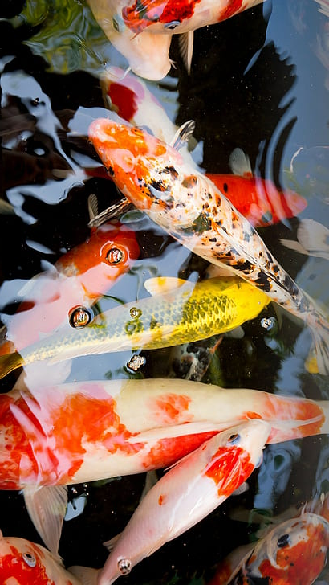
KOI DISEASE MONITORING SYSTEM
“Carpe Diem”
CHRISTYLMAGBANUA
JESSAMILGAR
EVA JEANSALUTIN
JESSA MAECANDOLADA
JOANA . ROMANA

Slide 2
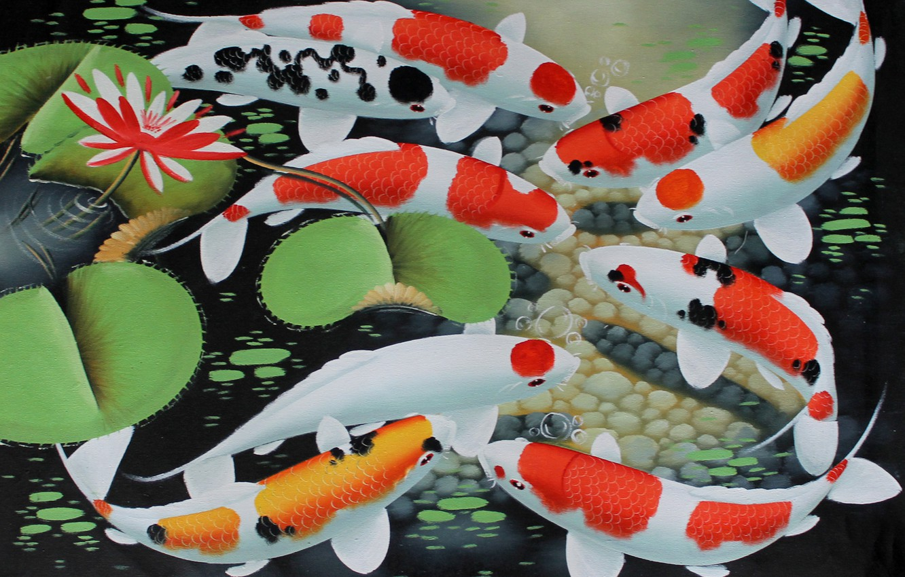
CHAPTER 1 INTROCUTION
“Carpe Diem”

Slide 3
INTRODUCTION
Overview of the current state of technology
Have you ever caught up about an aquatic animal that is often associated with strength of character, perseverance, accomplishment and courage? The said aquatic animal also symbolizes good fortune, wealth, success, prosperity and ambition. Yes, it’s the Koi fish also known with its scientific name “cyprinus carpio’’. Koi fishes’ legendary history and natural endurance also led them being associated with longevity of human existence.
Koi fishes are domesticated and tamed versions of a common carp fish. Koi fishes are renowned due to the combination of a dynamic array of colors that have been shaped and created via strict selective breeding. There are over twenty (20) different varieties of Koi fishes that vary in color, patterns and types of scales. This unique chromatic spectrum of colors makes them one of a kind and unique aquatic animal. Koi fish originates from Eastern Asia and usually lives in fresh waters. Due to the appreciation of its beauty and increased popularity in the past century, Koi fishes can commonly be found on ponds or residential fish tanks around the planet. Since Koi fish is abundant and kept in private aquacultures, it is not on the list of endangered species. Having this on our backyard fish pond or on our fish tanks brings us joy and most of us believe that it will give us a tremendously good fortune and prosperity. Therefore, we certainly need to take good care of the said fish. We should also recognize all the information on how to monitor them especially when they are in discomfort and need immediate assistance.

Slide 4
KOI DISEASE MONITORING SYSTEM
PROBLEMS
OBEJCTIVES
Few precise and detailed information relative to the said aquaculture.
some enthusiasts don’t know how to properly feed, determine the disease and cure;
no known device that can check the quality of water that is suited for Koi;
and; it is extremely confusing to tell if the pond or fish tank is over populated or not;
Develop a mobile app that has detailed information on Koi’s aquaculture;
create a platform that guides owners regarding food, major diseases that Koi experience and its cure;
integrate hardware that can monitor, sense acidity and temperature;
provide data on the ideal number of Koi that can be handled per given area.
evaluate and test the developed system using ISO 25010:2011 software engineering standard in terms of product quality and quality in use.

Slide 5
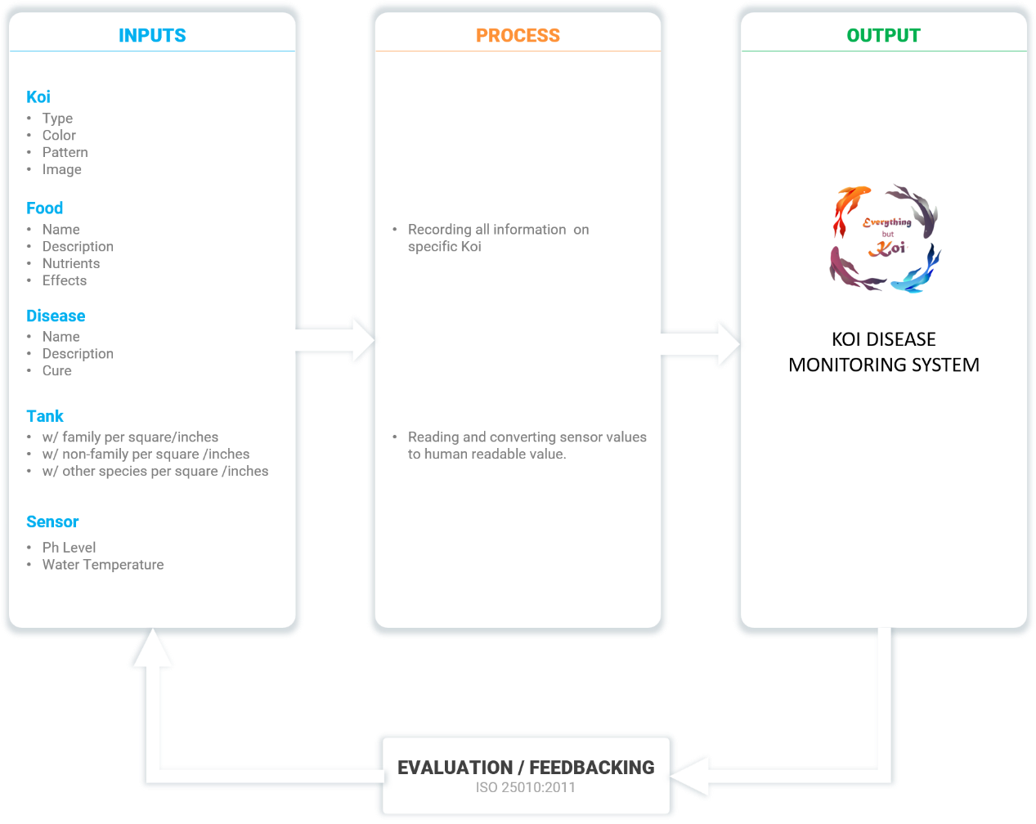
Conceptual framework
The selection of adequate concepts and efficient tools is imperative in the proposal of a Koi Disease Monitoring system. Thus, the following are the essential concepts that contribute to the development and implementation of the Koi Disease Monitoring System.

Slide 6
Definition of terms
PART 1
Koi. These are colored varieties of the Amur carp that are kept for decorative purposes in outdoor koi ponds or water gardens. (www.oxfordlearnersdictionaries.com/koi, 2020)
As used in this study, the term refers to the kind of carp fish that brings good luck to the owner.
Disease. It is a particular abnormal condition that negatively affects the structure or function of all or part of an organism, and that is not due to any immediate external injury. (www.oxfordlearnersdictionaries.com/disease, 2018)
As used in this study, the term refers to the condition that Koi experiences that causes them to be sick.

Slide 7
Definition of terms
PART 2
Fish Tanks. A large glass container in which fish and other water creatures and plants are kept. (www.oxfordlearnersdictionaries.com/us/definition/english/aquarium, 2020)
As used in this study, the term refers to containers where Koi fishes are stored.
Sensors. A device that can react to light, heat, pressure, etc. in order to make a machine do something or show something
As used in this study, the term refers to devices that sense temperature and acidity of water.
Aquaculture. It is the farming of fish, crustaceans, mollusks, aquatic plants, algae, and other organisms. It involves cultivating freshwater and saltwater populations under controlled conditions, and can be contrasted with commercial fishing, which is the harvesting of wild fish. (www.oxfordlearnersdictionaries.com/aquaculture, 2019)
As used in this study, the term refers to the overall ways of Koi farming.

Slide 8
SIGNIFICANCE OF THE STUDY
Koi Owners. The study and the system will be beneficial for they can monitor their fish tanks even if they’re away.
Koi Enthusiast. This study will be beneficial to them because they can get additional knowledge on how to take good care of their Koi.
Bureau of Fisheries and Aquatic Resources (BFAR). This study will be a great help to them because it can help them gain more information on how to manage the Koi fish raising industry.
Department of Agriculture (DA). The system and study will be an aid to them to increase their data on how to succeed in the Department of Agriculture (DA) aquatic sector.
Future Researchers. This will be a help for the future researchers for their related studies or for this study’s innovative advancement.

Slide 9
SCOPE AND LIMITATION
The study aimed to design and develop a system that can be used by anyone who has interest in Koi raising or those who were raising Koi already. The system is limited to the people who are connected to the internet and its service includes a real-time monitoring of Koi ponds or aquariums with the use of a sensing device that detects the acidity and temperature of water. Offline users could contact Bureau of Fisheries and Aquatic Resources (BFAR) phone numbers that are shown on the main page for immediate assistance or guidance.
The system provides all guides and information across different species and types of Koi Fish. The said system is compatible to almost all mobile devices that supports .apk or .ipa file extensions can suffice to run the mobile application.
The Koi Disease Monitoring System will be available in the Play Store for Android users and App Store for iPhone users. No account creation required.
The researchers work directly with the Bureau of Fisheries and Aquatic Resources (BFAR) for the proper terms and guidelines of the application. The application will be using the International Standards Organization (ISO) software engineering quality standard in terms of product quality and quality in use. The application will be evaluated by BFAR, five (5) IT experts, and five (5) Koi enthusiasts that will be the future users of the said system.

Slide 10
CHAPTER 2 REVIEW OF RELATED LITERATURE
“Carpe Diem”

Slide 11
SYNTHESIS
The study of Duk-jin (2006) has the same controlling device, either a laptop or PC (Personal Computer). In this study, any device that had a network connection was capable of controlling the system as long as it had a browser present within the device controller. The Study of Arora (2013), GSM Technology is used. Controlling appliances is done by sending SMS to the system. However, compared to the reaction time of physically connected wires to the GSM technology, the networking technology used by the researchers would perform faster than GSM technology because it is physically connected. The study of Gretarsson (2014) is used for industrial purposes, especially in the fishing industry where conveyor belts are used to minimize human labor. The researcher’s study was intended for use by home owners, specifically with internet connections, which the goal of the system was to control the framework using network connection.
The study of Karhu (2014) explains the improvements that can be integrated by control system to mechanical and hydraulic components applicable in commercial future machinery. The researcher’s study was intended only for the home owners and the satisfaction it can give to the users without the aid of the hydraulic or mechanical components.

Slide 12
CHAPTER 3 METHODOLOGY
“Carpe Diem”

Slide 13
PROJECT DESCRIPTION
The operation starts with any personal computer, laptop or any other devices which has a browser and network connection that will access the website of the system. If the user successfully accesses the site, he/she will be able to manage the monitoring system. After successfully accessing the site, he/she will be able to manage the koi by adding it, adding its food, current disease and to which container it must be added. The user can also view the koi’s food, disease, and container status. There is also a water quality check for the user to view.
In managing the system, all the user needs to have is a Personal Computer, Laptop or any devices that can connect to the network and has a browser to navigate the system.
If the user is offline due to an electricity problem, then they can also contact the Bureau of Fisheries and Aquatic Resources (BFAR) phone numbers that are shown on the main page for immediate assistance or guidance. The system provides all guides and information across different species and types of Koi Fish.

Slide 14
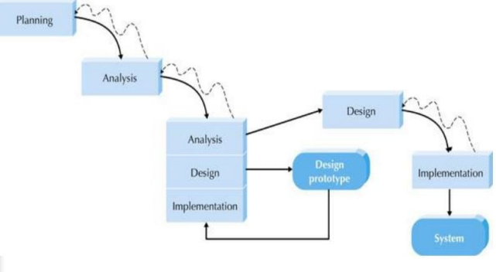
SYSTEM DEVELOPMENT LIFE CYCLE
Figure 2. A Throwaway Model Methodology
The koi disease monitoring system starts by planning on what are the things that need to be gathered and prepared such as the devices that the researchers will use in order to make use of the system and what would be the actual framework that the researchers will be using, after planning on what the system needs the researchers starts brainstorming on what kind of data the system will need, the researchers ended up listing all the possible requirements such as type of koi details, disease details, food details, and container details. After all the gathering of requirements, the researchers started designing on how the program should look based on its functionality. When designing was done, they checked other matters that should be necessarily added to the system. If the addition of other requirements is not completed, the researchers repeated the process until the system was functional and ready.

Slide 15
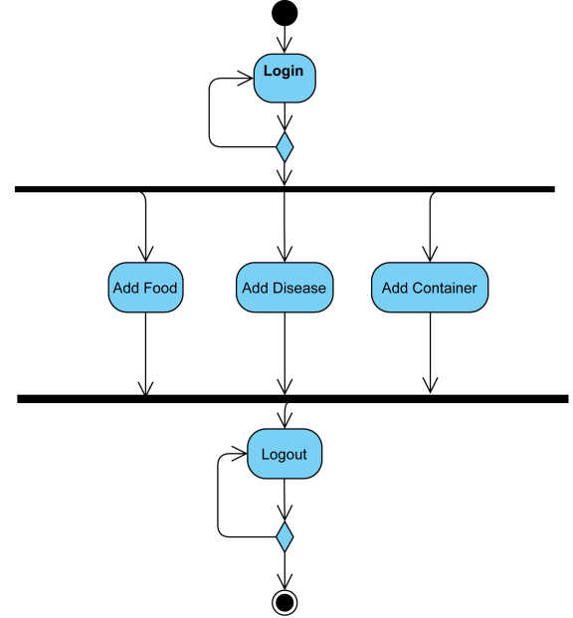
Administrator Activity Diagram
Shows the menus of the system, the administrator needs to login first, after login, there will be 3 buttons which is Add Food, Add Disease and Add Container. After that the administrator confirms its log-out.

Slide 16
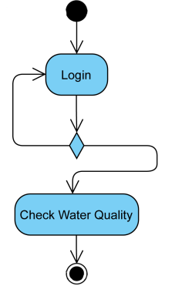
user Activity Diagram
Shows once the admin login it will see a check water quality button, once clicked it will display the real time data that is projected by the pH Sensor and Temperature Sensor that is coming from the Raspberry Pi.

Slide 17
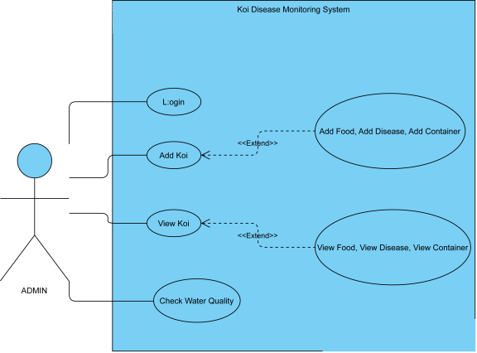
administrator use case Diagram
Shows the use case diagram showed how the administrator manages the entire system. The administrator will first login to the system, after login the admin will be able to add koi or its details like food water and diseases. The admin could also view koi or the said details or check the water quality.

Slide 18
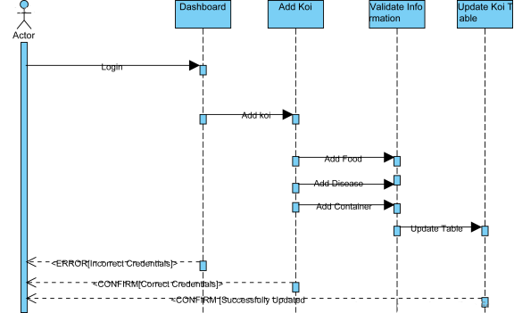
adding koi sequence Diagram
Shows the admin needs to login as always, once login credentials is incorrect the system will prompt a message saying “Login Failed: Incorrect Credentials”, once the credentials is correct it will send a message “Login Successful: Correct Credentials”. Now the Administrator can Add Koi, Once adding koi the administrator will need to fill-up the form that will have the type of food the koi needs, type of disease the koi currently have and on what tank it needs to be put in. after saving that there will be a confirmation message from the system that the details were saved successfully and the system will update its table. Same goes to

Slide 19
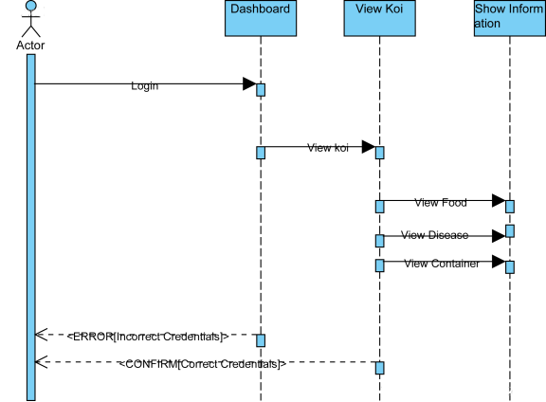
viewing koi sequence Diagram
Shows same process as figure 6 but the process is exclusive only for viewing purpose.

Slide 20
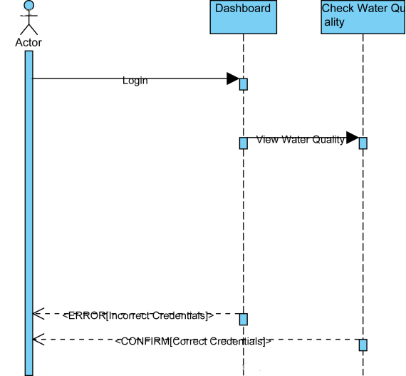
Checking water quality sequence Diagram
Shows the sequence diagram for users on how to check their water quality. This means that the administrator can view the current status of the tank’s water quality.

Slide 21
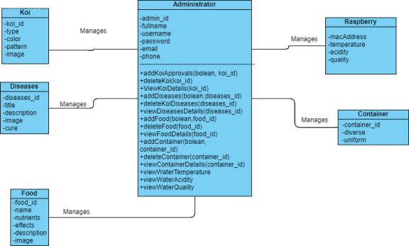
class Diagram
Shows the entity composed with attributes and operations that the system will be using. The administrator will be the one managing the system by adding the koi details, disease details, food details, container details and by checking the water's temperature and acidity. The system will also have access to the raspberry pi that will store the real time water temperature and water acidity, by calculating both measurements will determine the quality of the water.

Slide 22
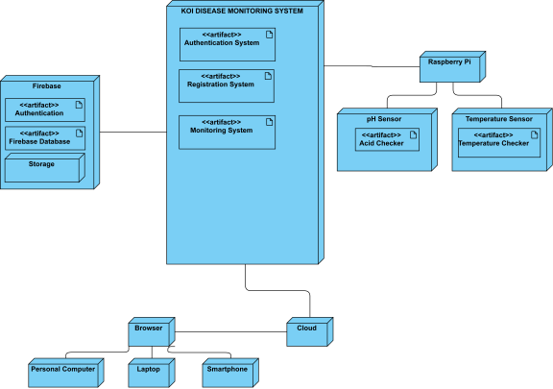
Deployment Diagram
Figure 10 shows that when the admin accesses the system using the website, he/she will be able to manage the system by navigating the website. Figure 12 shows the diagram workflow of the system. The browser will be accessed by using either personal computer, laptop or smartphone, the system will be stored to the cloud with a firebase database and it is also connected to the raspberry pi which will be the main component of measuring the water acidity and water temperature

Slide 23
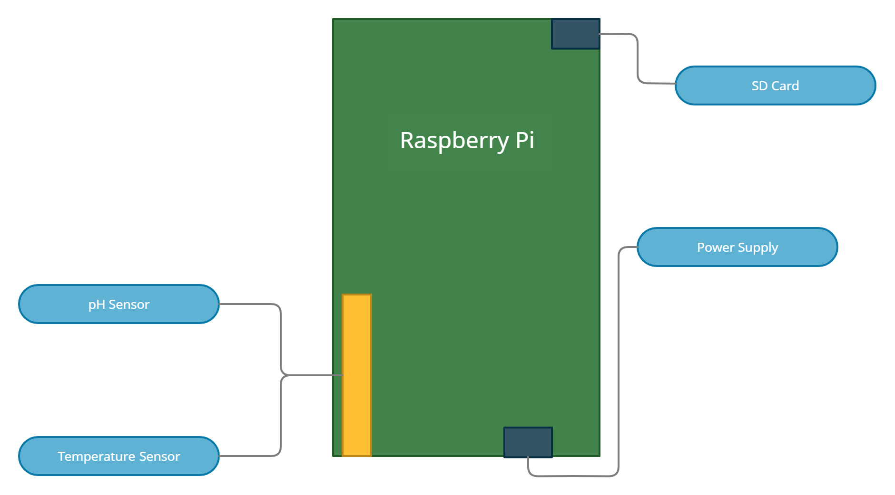
Block diagram Diagram
Figure 11 showed the block diagram for the koi disease monitoring system. raspberry pi will be the main component that will be connected with the pH sensor for checking the acidity of the water, temperature sensor for the warmness or coldness of the water, SD card for the operating system (OS) that will be used on the raspberry pi and the power supply that will be used to power the raspberry pi. By using the onboard wireless lan (WLAN) of the raspberry pi, it will be able to connect to the internet.

Slide 24
Project evaluation
In this study the researchers use the ISO/IEC 25010 as the guidelines in evaluating the koi disease monitoring system. This includes the following characteristics:
Functional Suitability. It is the degree to which the s
et of functions cover all the specified task and user objectives.
Performance Efficiency. It is the degree to which the response and processing times and throughput rates of a product or system, when performing functions, meet requirements.
Efficiency. It is the resources expended in relation to the accuracy and completeness with which users achieve goals.

Slide 25
Thank you !
“Carpe Diem”
CHRISTYLMAGBANUA
JESSAMILGAR
EVA JEANSALUTIN
JESSA MAECANDOLADA
JOANA . ROMANA

